Slide 1
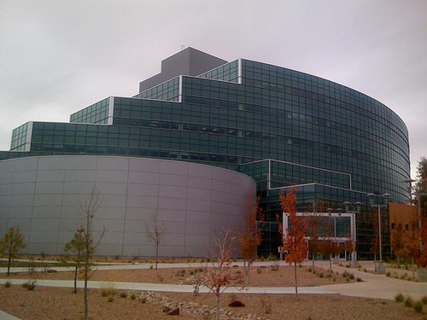
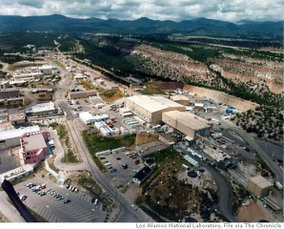
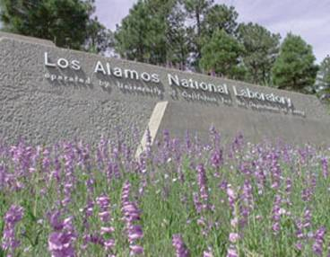
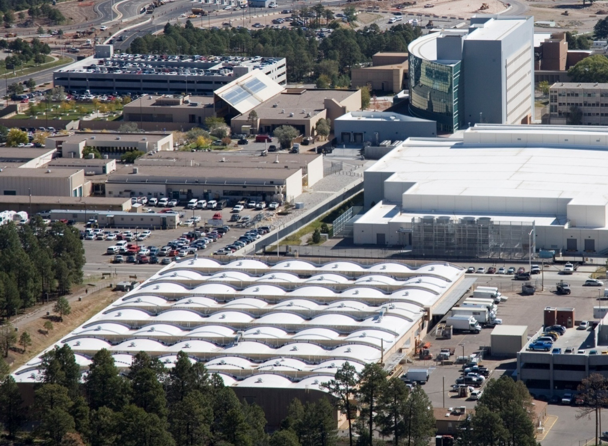
2010
Materials
Management
Workshop
Doug McCrary, Division Leader
Acquisition Services Management (ASM) Division
Los Alamos National Laboratory
May 11-13, 2010
Santa Fe, New Mexico
W
W
W
Operated by Los Alamos National Security, LLC for DOE/NNSA

Slide 2
Acquisition Impact in FY09
Annual Lab Budget: $2.2 billion.
Goods and Services Procured: $740 M
Professional & Technical Services: $258M
Consulting, training, project management, safety & security, professional services, IT services
General Products: $224M
IT Hardware, General commodities, chemicals, and general hardware
Environmental Remediation Services: $110M
Construction: $86M
Architect-Engineering services, General Construction and D&D services
Miscellaneous: $43M
Facility & Equipment maintenance, rents and utility services, fabrications
Research & Development: $18M
Operated by Los Alamos National Security, LLC for NNSA

Slide 3
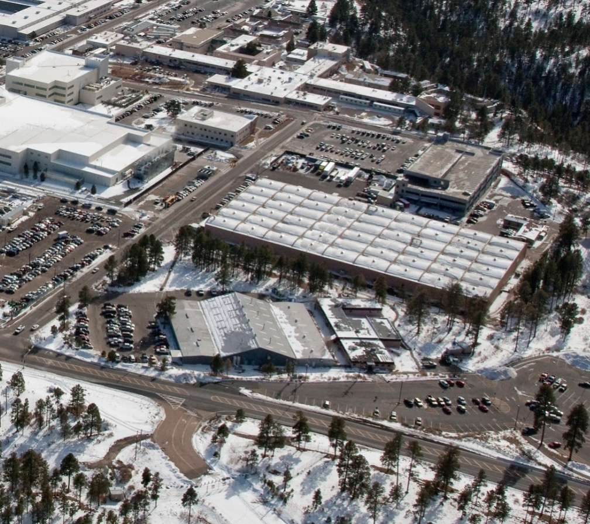
Materials Management Operations
Warehouse was constructed in 1952.
Approximately ~115K square feet.
Has always served as the central receiving, distribution, and shipping/traffic services center for the Laboratory.
Also the general stores warehouse for the entire Laboratory until the store’s inventory was phased-out in ~1990 with the introduction of Just-in-Time (JIT) and now Blanket Order Agreements.
In 1997, the Laboratory’s Mail services operation was relocated to the Warehouse.
Current staff of 60, which includes manager, LANL employees, contractors and students.
11 mail cars, 10 general delivery trucks, 4 large freight trucks, and 21 forklifts
Operated by Los Alamos National Security, LLC for NNSA

Slide 4
Operational Volume
Service Area ~43 sq. miles
In-bound packages and internal deliveries ~216K annually
Distributes to 350 drop points
Out-bound shipments ~14K a year
Mail ~2.4M pieces a year to 650 mail stops
Mailroom also picks up recycle materials in conjunction with LANL Environmental Programs
Bulk/junk mail ~120tons a year
5K toner cartridges a year
2K boxes of binders
Operated by Los Alamos National Security, LLC for NNSA

Slide 5
Materials Management Highlights
One of the challenges that Laboratory materials management has encountered is the method of acquisition.
Recent developments in acquisition methods at LANL include:
Wireless Receiving
Blind Buy
Operated by Los Alamos National Security, LLC for NNSA

Slide 6
Blind-Buy
Blind-Buy is the new Laboratory IT methodology for the Procurement, Receiving, Hardening, Deployment, Salvaging
Implemented to standardize IT procurement methods, promote Information Architecture standards, lower acquisition costs, enhance cyber security posture, lower deployment costs and minimize IT footprint
Incoming IT orders are now hardened before being delivered to end-user
Blind-Buy units processed:
3248 units in FY09 (April 2009 – Sept 2009)
2498 units in FY10 thus far (Oct 2009 – Apr 2010)
Operated by Los Alamos National Security, LLC for NNSA

Slide 7
Wireless Receiving
Launched March 1, 2010
In-bound packages and internal deliveries ~216,000 annually
Previously processed manually – receiving, scanning, downloading and transferring data
Wireless technology required Security Enclosure Plan to DOE, subsequent training and system testing
Already greatly reduced time required to process incoming goods, and increased timeliness and accuracy of LANL payment to vendors.
Operated by Los Alamos National Security, LLC for NNSA

Slide 8
Disposition Activities
Excess an average of ~9,000 barcode items a year.
E.g., ~80% IT-related and 20% rolling stock
Reutilized internally/externally ~900 barcode items a year.
Bulk of reutilized items are rolling-stock items
Average net revenue from sales is ~425K.
Operated by Los Alamos National Security, LLC for NNSA

